Slide 1

House Of Hope Team 17
Karla L Booker MD FACOG FAAFP
Sameer Doshi
Anne Lang Dunlop MD FAAFP
Arlene C Mabrey
September 26, 2021

Slide 2


A Day At The Office
Ok! Next patient
is a New OB patient!
Hey, Dr. Booker.
I’m Sheena!
Notes:
A Day At The Office title slide

Slide 3



My Inner Voice
“She’s not going to
have support.”
“I hope she knows
how serious this is.”
“She’s going
to need more
than I can provide.”
“She’s going to miss appointments.”
“She’s automatically
high-risk!”
“She’s already
overweight.”
Notes:
My inner voice

Slide 4
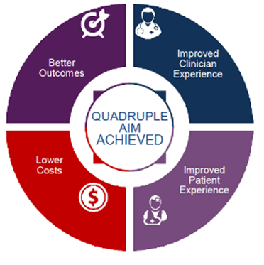
The “Why” Of It All
67% of all maternal deaths are PREVENTABLE!
60% of all pregnancy-related deaths occurred in Black women
a Black woman is 3 times more likely to die during and after labor than her White counterparts
and 1.5 times more likely to deliver prematurely
a proactive approach to transforming care translates into saving lives & dollars
$4,000-$6,000 saved for every severe adverse labor event that occurs
$55,000 saved for every premature delivery that is prevented
Notes:
Change font of title & black

Slide 5

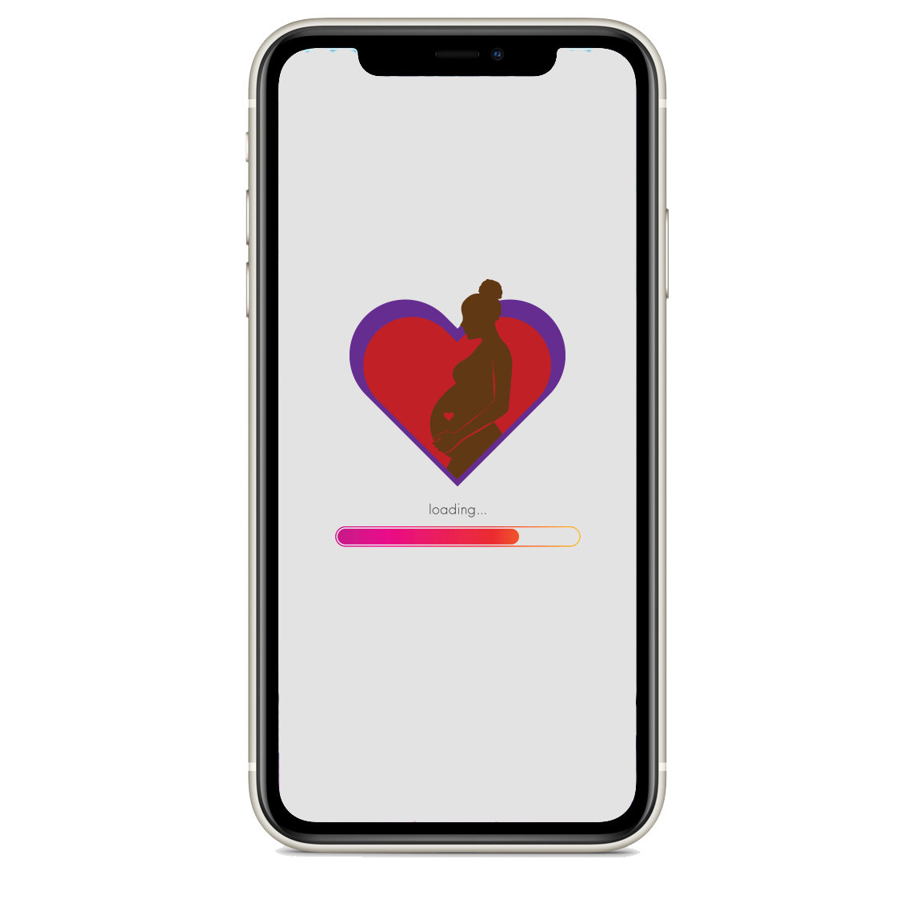
HOUSE OF HOPE APP
Electronic Medical Record
Pre-& Post-natal care: Physicians/ Midwives/Doula
Social Workers
(Mental health, insurance asst, etc)
HoH SMART App Link
(Smart on FHIR)
Community Building/Group prenatal visits
YOU
Matter
Nutritionist
YOU carry the future
YOU are valuable
Pharmacy Resources
Transportation
Notes:
And you know what the frustrating thing is the tech already exist and we just need to bring forward. And that is what our App will do. Educate and give access to EVERYone in the Atl Metro to the House of Hope medical home…..the House of Hope. We are
SMART on Fhir is standard application allowing easy and secure extension of an EMR into Cloud Based applications.
Get to the use case faster….
What does this App do???????? MAKE it CLEAR
The resources already exist and now Sheena is at the center of the health care eco-system
Smart phone use ease. Because the NOOM App stats in the Atl metro area support high tech comfort
Implementation – How easy will this be?
Create journey map high level – Sameer is this what Sumeet can help with

Slide 6
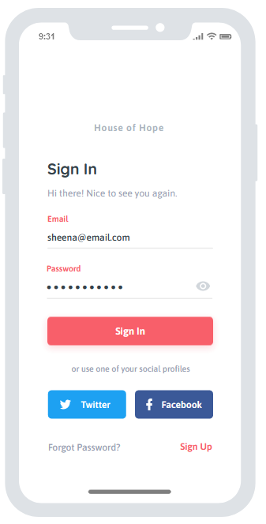
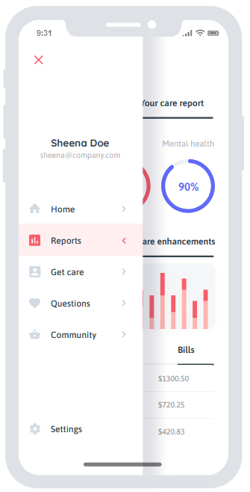
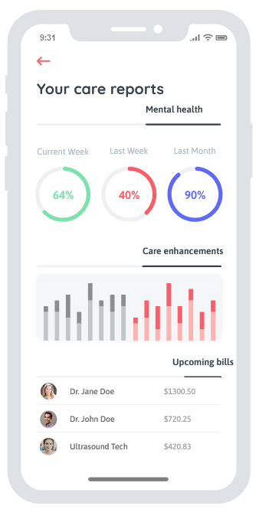
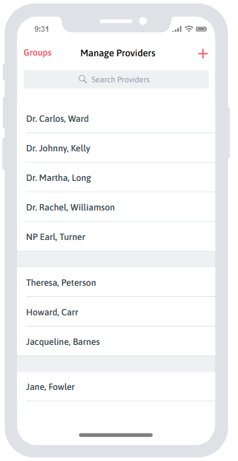


What Sheena will see
sheena@email.com

Slide 7
Implementation Plan: HOUSE OF HOPE Pregnancy Medical Home
Phase 1
Phase 2
Phase 3
Phase 4
Development
Pilot
Evaluate
Scale
Timing | Months 1-3 | Months 4-12 | Months 6-12 | Months 12-18
Key Activities Data | Design & refine prototype Stakeholder feedback & Application iterative development Develop iterative change management protocol Estimated cost: $25,000 – mobile app development $5,000 – annual maintenance $20,000 – EMR app development $5000 – annual EMR maintenance $2,500 – hosting fee for HoH app Sized at 1-100 user basis, with incremental increases for additional users Capture & organize metrics on target population, baseline morbidity rates, & interactions | Run pilot with the following hospital networks, including OB providers that deliver at these institutions: Emory DeKalb Medical Center Wellstar Atlanta Medical Center Piedmont Henry Medical Center Northside Gwinnett Medical Center Benchmark success criteria through pre-pilot surveys | Gather mid- & post-pilot feedback Compare pre and post surveys Determine feasibility Determine changes needed Implement enhancements Qualitative data from surveys will be used to qualify further development | Iterative scale-out (1) Scale to ~20 Greater Atlanta Metro area hospitals Re-evaluate feasibility for rural areas considering factors such as internet connectivity, distance to care, literacy, etc. (2) Scale out to high morbidity population rural areas Continue to iterate Quantitative data will be available as each patient completes the 18 month cycle

Slide 8
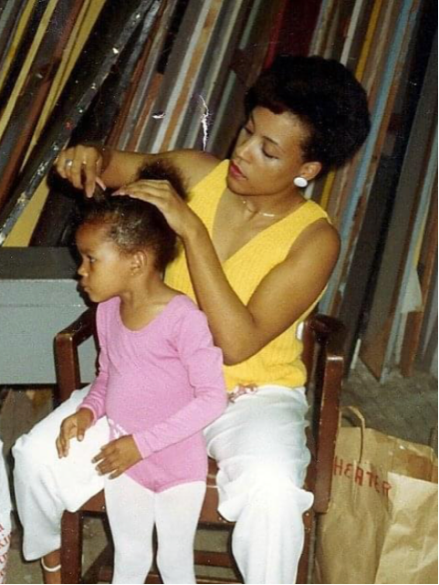
I am Sheena
Notes:
If I had this I would have seen the early warning signs. My Dr. would have know how to care for me better.

